Slide 1
LTE Architecture

Slide 2
LTE architecture
LTE, which stands for Long-Term Evolution.
It is a standard for wireless broadband communication.
It is a technology used for 4G (fourth generation) mobile communication networks.
The LTE architecture is designed to provide high-speed data transfer, low latency, and improved spectral efficiency compared to previous generations of mobile networks.

Slide 3
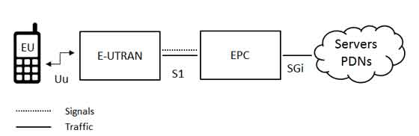
The high-level network architecture of LTE is comprised of following three main components:
The User Equipment (UE).
The Evolved UMTS Terrestrial Radio Access Network (E-UTRAN).
The Evolved Packet Core (EPC).
The evolved packet core communicates with packet data networks in the outside world such as the internet, private corporate networks or the IP multimedia subsystem. The interfaces between the different parts of the system are denoted Uu, S1 and SGi as shown below:

Slide 4
The User Equipment (UE)
The internal architecture of the user equipment for LTE is identical to the one used by UMTS and GSM which is actually a Mobile Equipment (ME). The mobile equipment comprised of the following important modules:
Mobile Termination (MT) : This handles all the communication functions.
Terminal Equipment (TE) : This terminates the data streams.
Universal Integrated Circuit Card (UICC) : This is also known as the SIM card for LTE equipments.It runs an application known as the Universal Subscriber Identity Module (USIM).
A USIM stores user-specific data very similar to 3G SIM card. This keeps information about the user's phone number, home network identity and security keys etc.

Slide 5
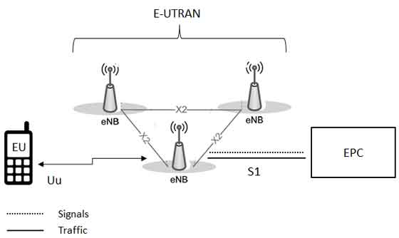
The E-UTRAN (The access network)
The eBN sends and receives radio transmissions to all the mobiles using the analogue and digital signal processing functions of the LTE air interface.
The eNB(eNodeB) controls the low-level operation of all its mobiles, by sending them signalling messages such as handover commands.

Slide 6
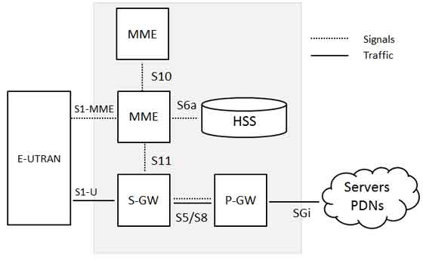
The Evolved Packet Core (EPC) (The core network)
The Home Subscriber Server (HSS)
The Packet Data Network (PDN) Gateway (P-GW)
The serving gateway (S-GW)
The mobility management entity (MME)
The Policy Control and Charging Rules Function(PCRF)

Slide 7
